Slide 1

Volunteering Website Guide
How to register and advertise your opportunities

Slide 2








Quick Links
If you are a new user please follow the guide through. If you are already registered and just need to jog your memory, use the quick links to jump to where you need to be.

Slide 3
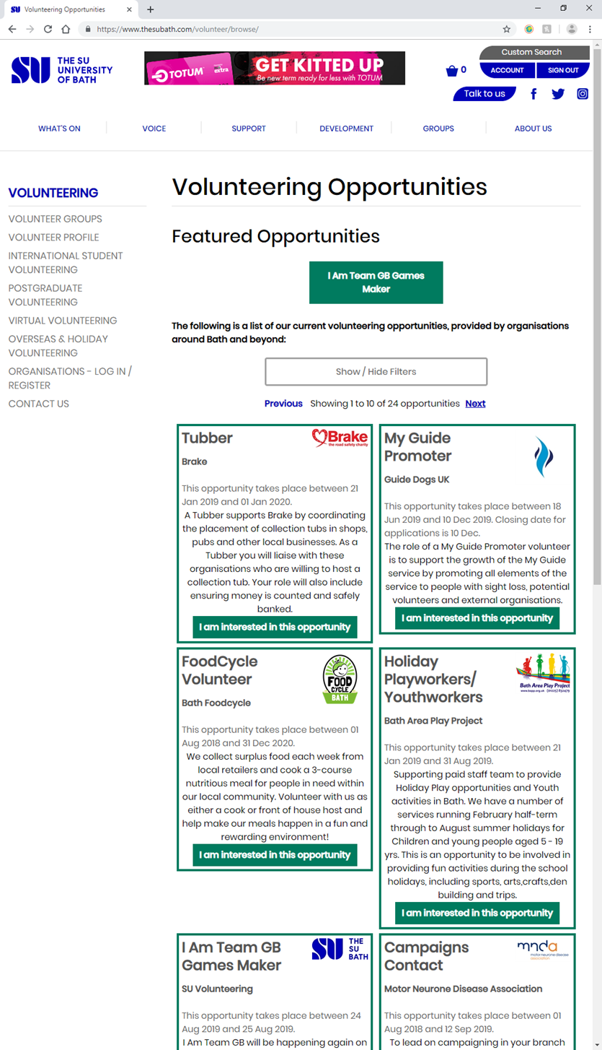
What is the Volunteering Module?
The Volunteer Module is the hub for students to find volunteering opportunities among local and national charities as well as from SU Activity Groups including V Team, Student Volunteering and RAG (Raise & Give). As a charity or non-profit you can have a free account to advertise your opportunities.
This is what the students see.
www.thesubath.com/volunteer/browse/

Slide 4
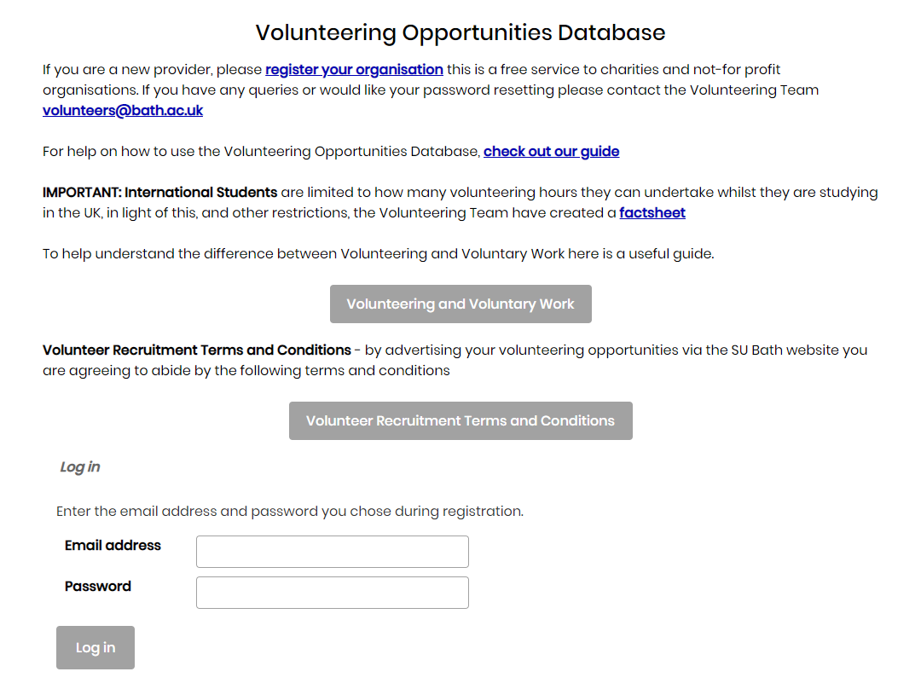
Register / Log on:
www.thesubath.com/volunteer/providers/login/
This is your main link and
will help you access
everything you need.
Register
Contact us
This help guide
Useful info
Ts & Cs
Log in to your account
1
2
3
4
5
6

Slide 5
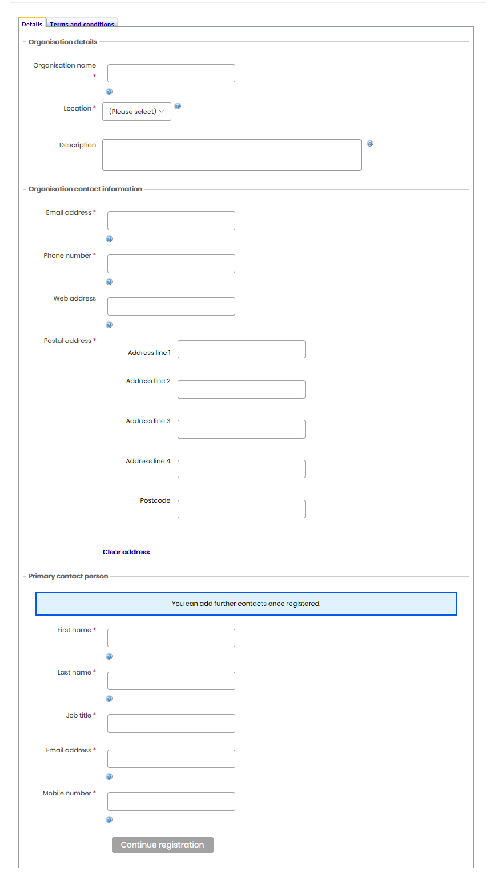
How to register
The link from the previous slide will take you to this page. Here you will need to enter your charity's details and yours.
You need to register as one person at the moment. You can add more people later.
Once you have done this click Continue registration

Slide 6
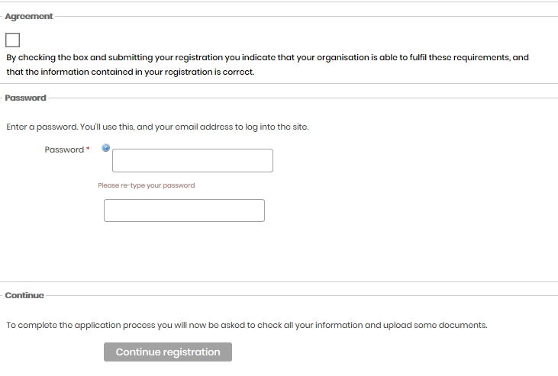
How to register
The next page is our terms and conditions. (These can be viewed on your home page.)
You will then create a password and click confirm registration.
When creating a password use something simple - this page doesn’t like numbers. You can change the password later to something more complicated.
Once you have confirmed your registration you will be taken to your incomplete profile.
At this stage you can log out and continue the registration at another time
Currently you profile HAS NOT been submitted to us for approval
Log back in: www.thesubath.com/volunteer/providers/login/

Slide 7
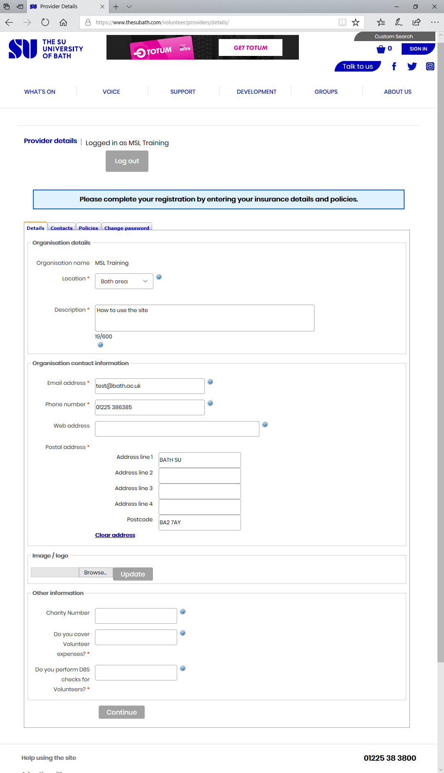
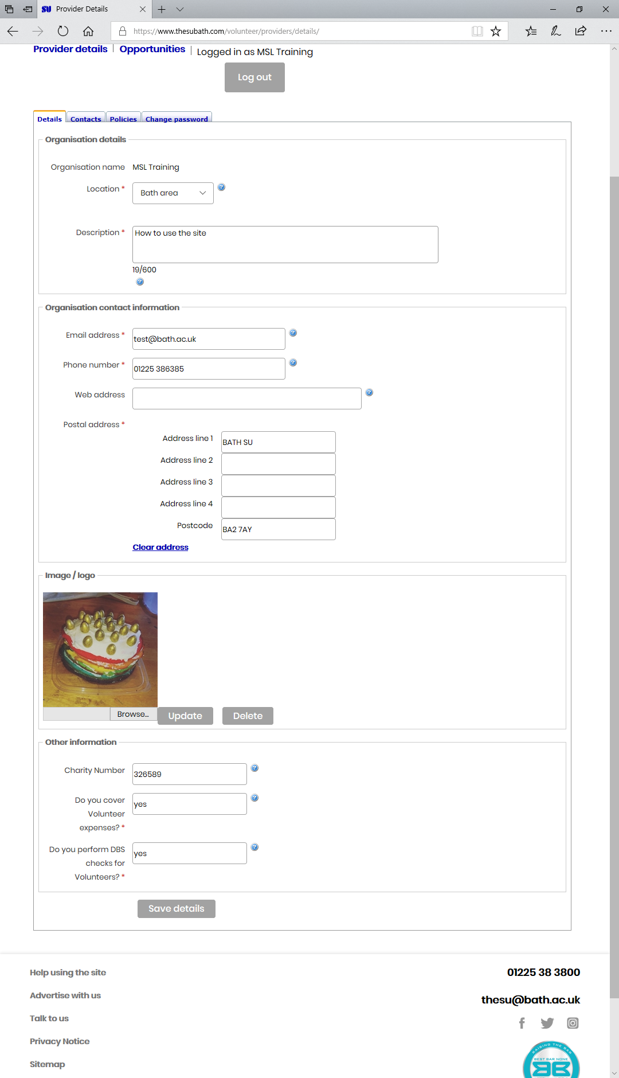
Continuing registration and editing your details
Your incomplete profile will look like this:
1
Who is logged in
Log out
Your details
Adding and removing access. (Additional people who can add opportunities for your organisation.)
Your policies
Change your password
Once you have been approved the add opportunity button will show.
2
3
4
5
6
7

Slide 8
Your Details
This is all your basic information:
This page will mostly be populated by information from the initial registration. You just need to fill in the blanks.
Insert a logo here. Use Browse to find your logo and then Update to insert. It will then show if it has been accepted.
When you have finished this page click Save details

Slide 9
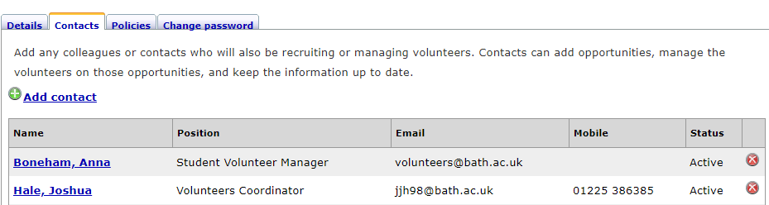
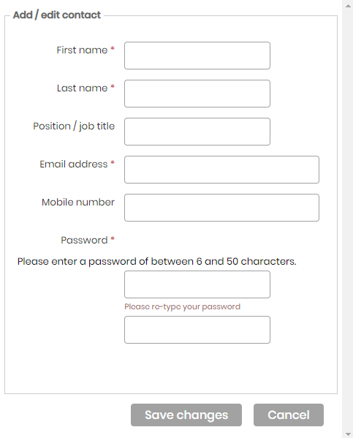
Contacts – Add or edit users
This is who can add opportunities for you:
Add a new user/contact
Add new user screen
Your existing users, click the name to edit details and change password
Deactivate a user
1
3
4
2
To change a password,
click on the name of the person and then enter a new password. You can reset anyone's password in your organisation.

Slide 10
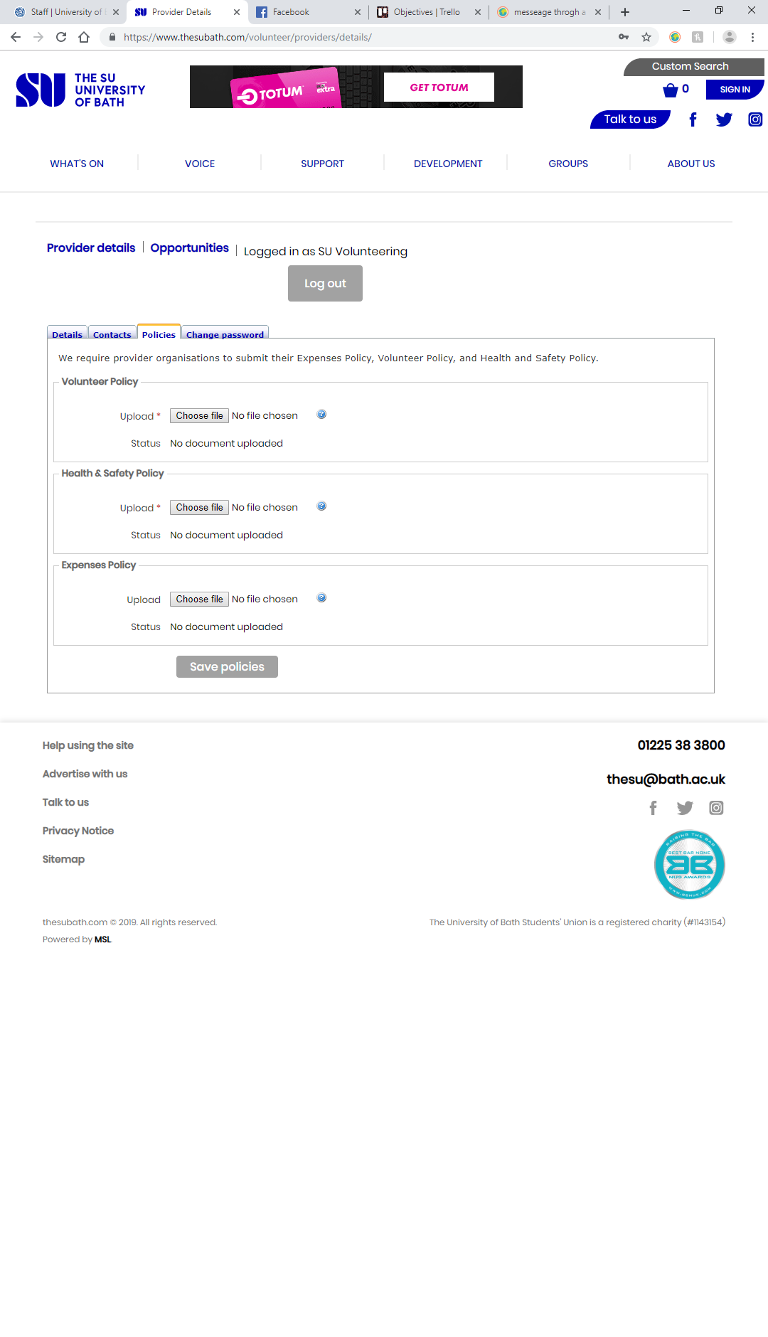
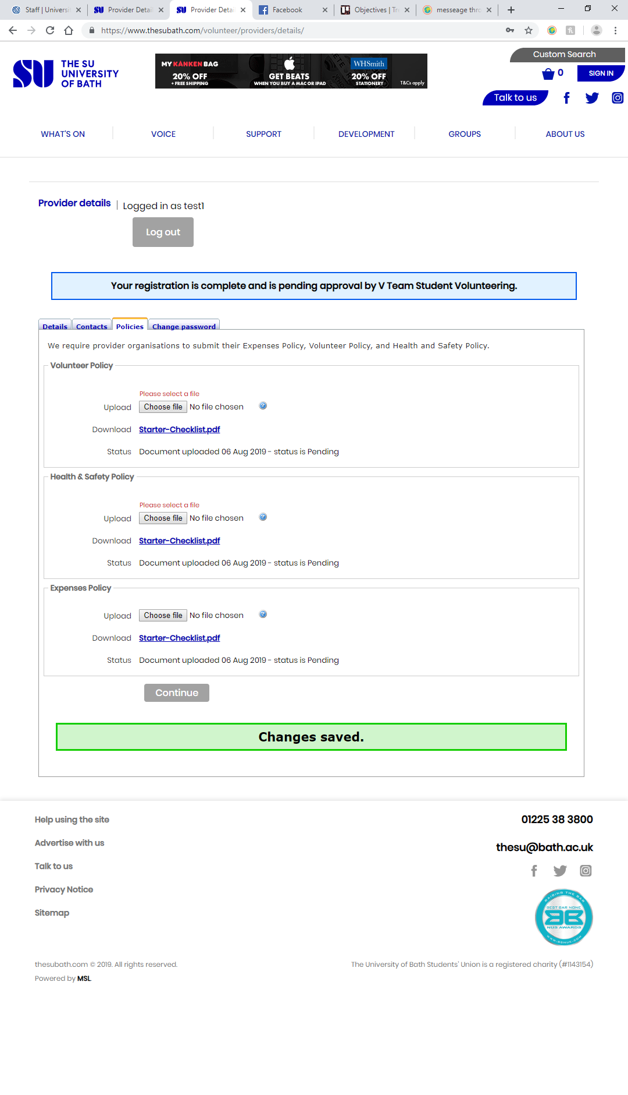
Policies
This is where you can upload your policies so we can see how you support and safeguard volunteers:
Add your Volunteer Policy
Health and Safety Policy
Expenses Policy
Submit profile for approval
If you have one document that contains all three sections upload it three times or drop us an email if you are having an issue.
Try and remember to update your details here when you update your organisation.
1
2
3
4
When you are registering this will say continue, click this to upload your policies and submit to us. You may need to click twice, once to add policies and once to submit to us

Slide 11
Submitting for approval
Once you have completed all your details you can send it to us for approval: once granted you can add opportunities.
We have to manually check every profile and approve them one at a time, so at busier times there may be a slight delay.
If you have not been approved within 48 hours, email volunteers@bath.ac.uk

Slide 12
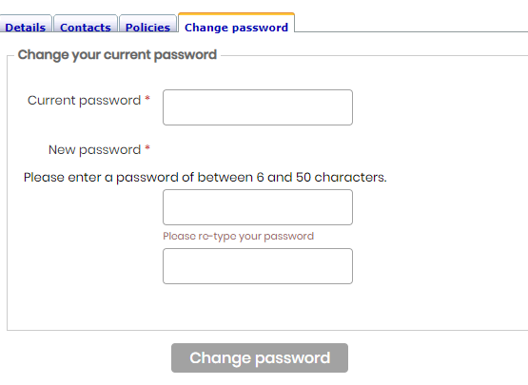
Change password
If you need to change your password here is another place you can do it:

Slide 13
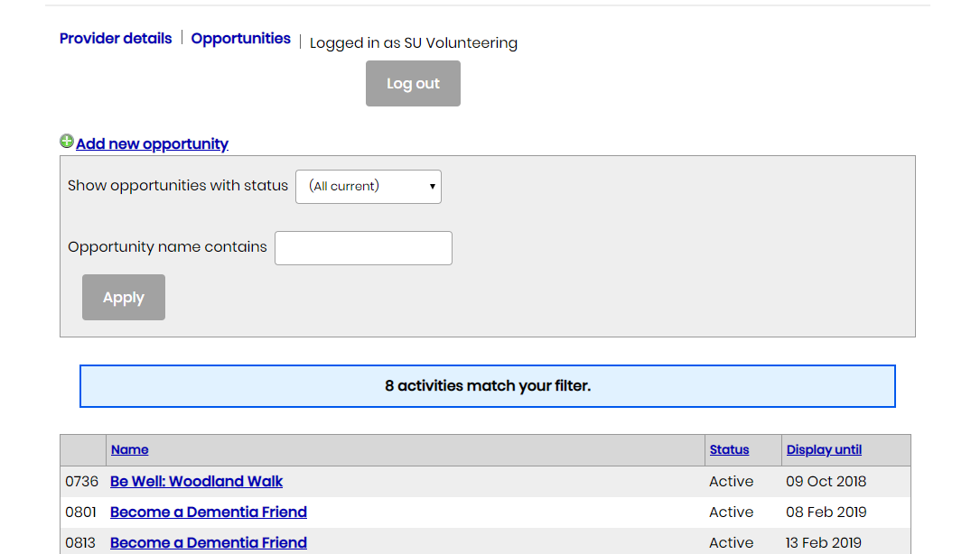
Adding an activity (Volunteering Opportunity)
After logging into your approved account you can advertise opportunities. Login at: www.thesubath.com/volunteer/providers/login/
Ensure you are on the Opportunities tab
Click here to add a new opportunity
Search existing opportunities
Your opportunities
1
2
3
4

Slide 14
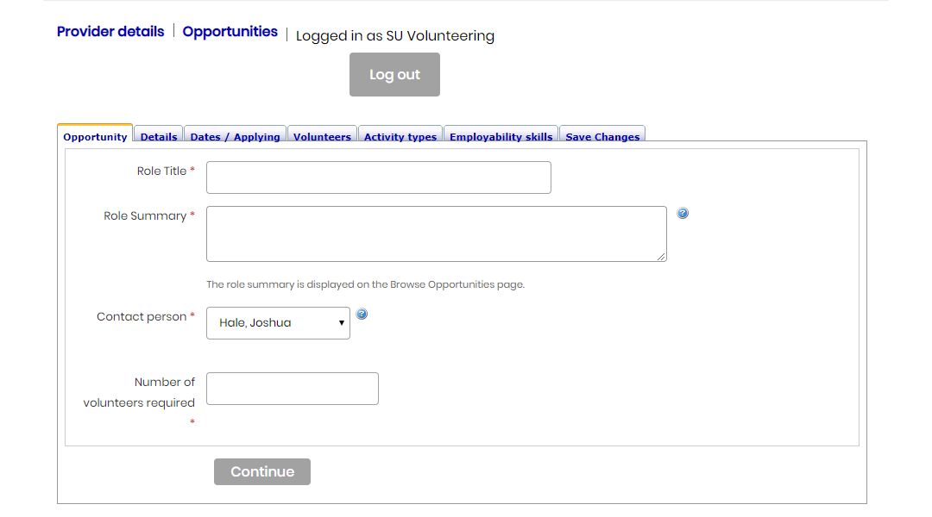
Adding an activity page
When you want to add an activity this is what you will see:
The main opportunity
What do users need to know
The dates of the opportunities
Who are you looking for?
What type of volunteering
What will the students gain?
Save the opportunity and submit to us for approval.
1
2
3
4
5
6
7

Slide 15
Adding an activity page
This is where you enter the basic details that the volunteer will see from the recruitment page:
What is the role you need?
Short description of the role this will display on the advert.
Who will receive the notifications about the role?
How many volunteers do you want.
Once you have finished this page click Continue
1
2
3
4
When naming the role avoid letting people assume they need specific skills or if they do make it clear in the role description.

Slide 16
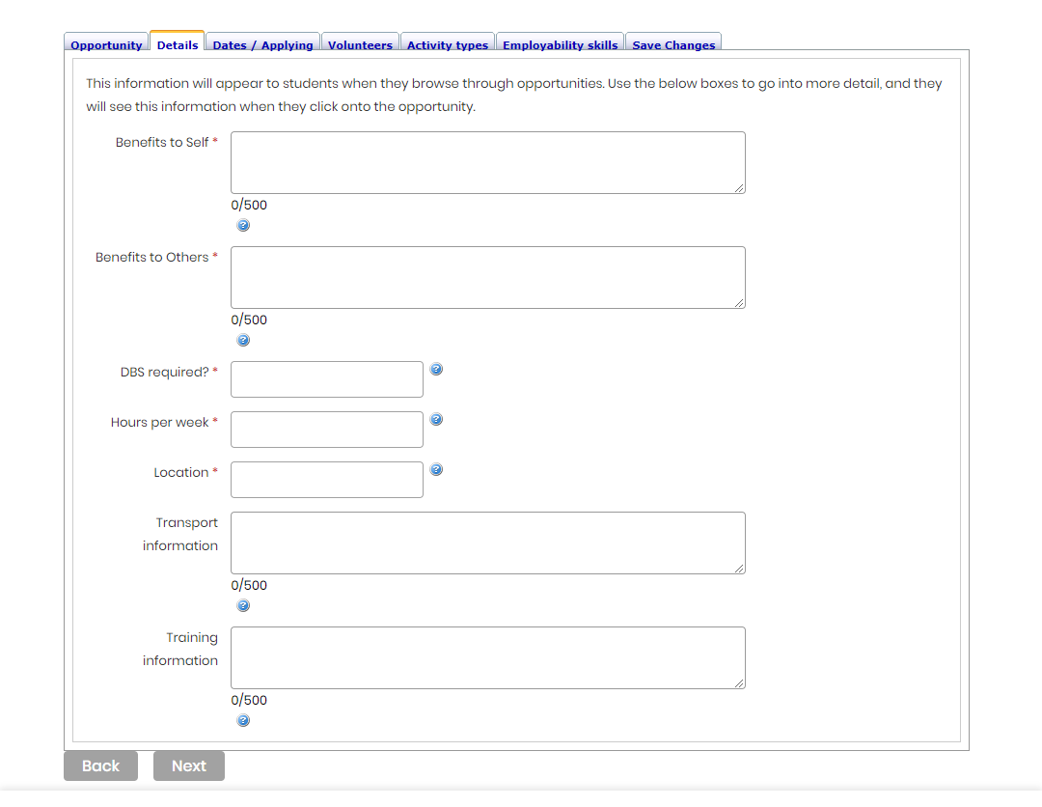
Adding an activity page
What does the opportunity entail?:
What will the volunteer gain from this experience?
How will they help others?
Do they need a DBS?
How many hours a week?
Where will they be volunteering
How can they get to you?
Will there be mandatory training?
Once you have finished this page click next.
1
2
3
4
5
6
7

Slide 17
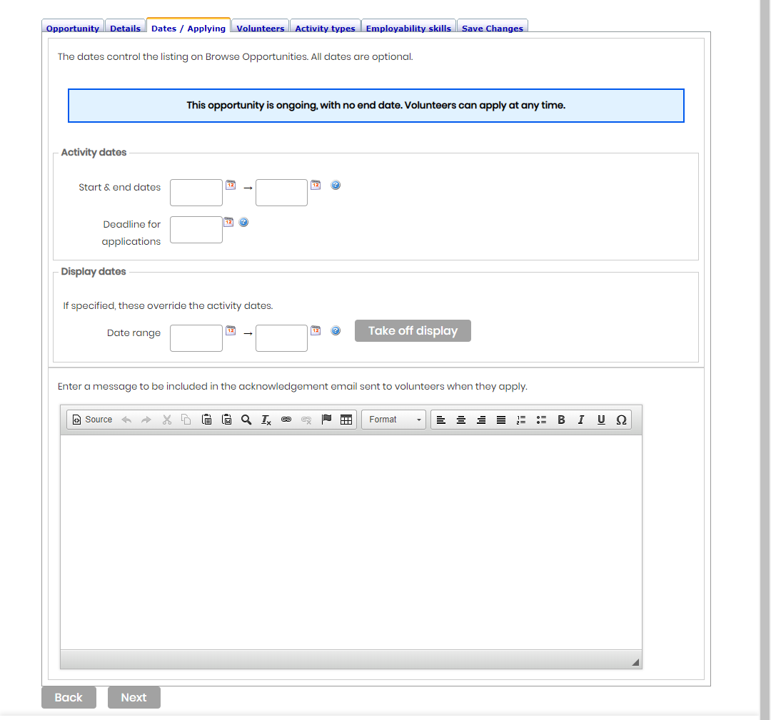
Adding an activity page
When is the opportunity:
When will the opportunity take place?
When is the application deadline?
When do you want it on the website? You can upload an opportunity now to show later or you can log back in and change the display date.
You can add an automated response that volunteers will receive after they click to express interest.
Once you have finished this page click Next.
1
2
3
4

Slide 18
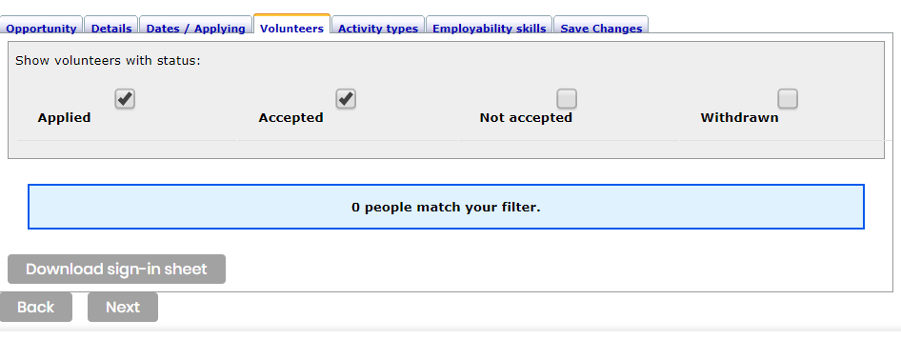
Your Volunteers:
When is the opportunity:
1
Here is how you sort through your interested volunteers.
This is where you will see who is interested in your opportunity. You will be provided with their name, email and phone. Next to each person will be a red and green circle. Use green to accept the volunteer and red to reject. This lets us know how many people we have in the community.
Here you can download your accepted volunteers and their next of kin information.
2
3
Once you have finished this page click next.

Slide 19
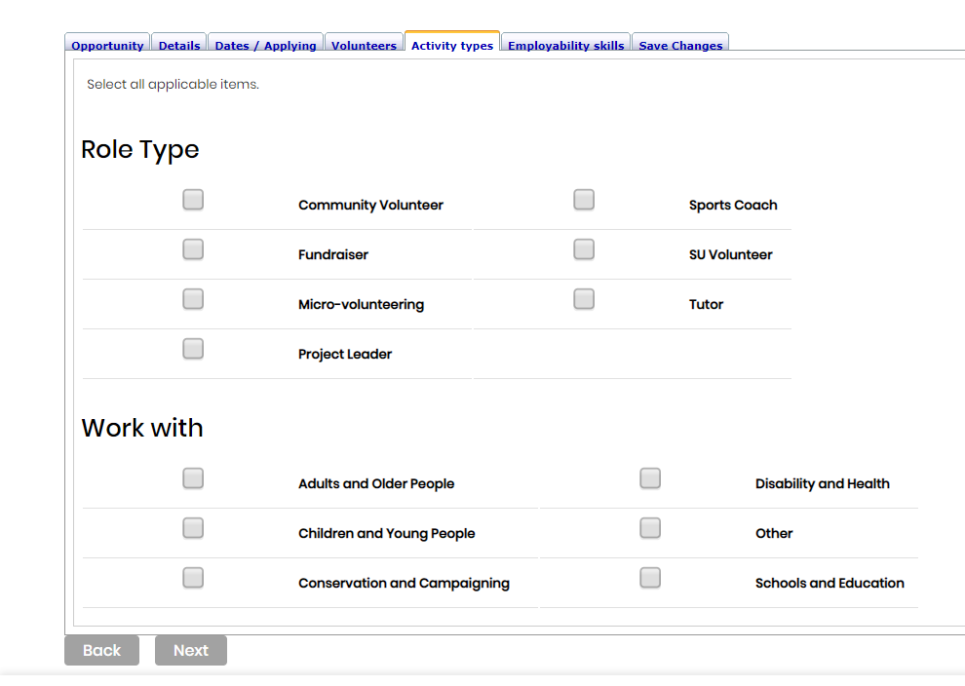
Activity Type
Where would you like to come up in filters?
What is the role type? Usually for an external charity it will be Community Volunteer or Fundraiser.
Who will the volunteers predominantly be working with or supporting?
1
2

Slide 20
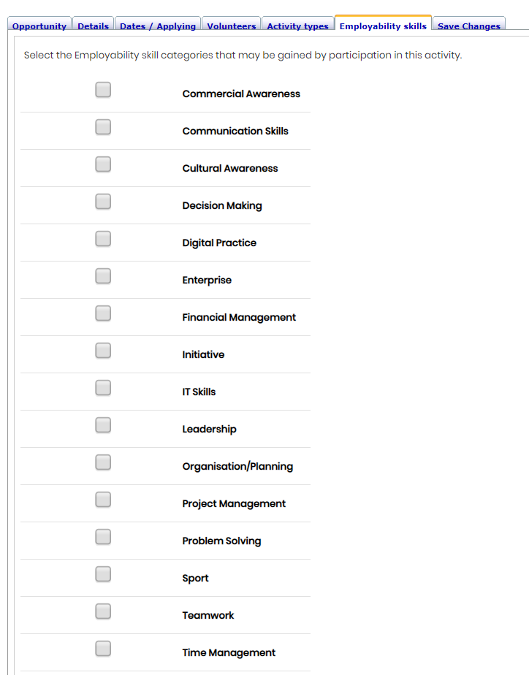
Employability skills
Final step!
This page is about the skills the volunteer will develop.
Once you have finished the page click the Save Changes tab and this will submit the form to us for approval.
Once approved volunteers will be able to sign up.
Check regularly for interest and keep in touch with them.

Slide 21
Top Tips
Be clear about what the role involves and don’t over sell it
Don’t put up open ended adverts. Using a deadline will speed up applications: without one people may put off applying.
Use a logo as it will attract students’ attention to your advert.
Stay in touch with the volunteers and send them a personalised email when they express interest.
Remember that volunteers have deadlines and exams: be mindful that they may not be able to volunteer as much at certain times.
If you are stuck ask us for help.
If you are struggling to recruit also get in touch as we can see what we can do to drum up interest.

Slide 22
Re-registering after and SU Update – Annually
Log in to your profile:
thesubath.com/volunteer/providers/login/
Check all your details are correct and up to date
Check all your users are still with your organisation
Check your policies are up to date
At the bottom of the polices tab click Save changes and it will resubmit for re-approval.

Slide 23



Say hello
volunteers@bath.ac.uk
thesubath.com
@thesubath
@thesubath
@thesubath

