Slide 1

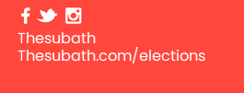
Be an
Academic Rep
Work in a team. Improve your academic experience. Collaborate with Academic Staff. Improve communication skills. Develop confidence. Join a community. Improve your employability. Be part of positive change.
Nominations Close:
DAY XX MONTH at TIME
Stand online:
thesubath.com/elections

Slide 2
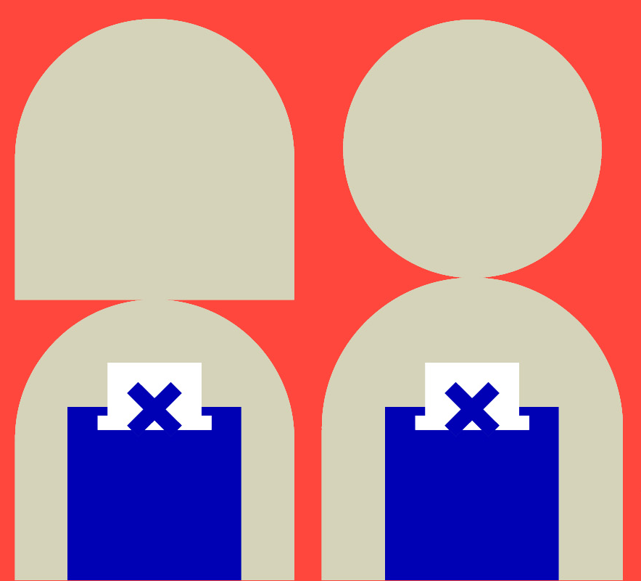
Vote for your
Academic Rep
Your academic rep can voice the changes that you want to see.
Who do you want to represent you?
Make your Choice and vote online.
Voting Closes: DAY XX MONTH at TIME
Vote now: thesubath.com/elections

